Slide 1
Stat 610 Class Project: Ship Valuation
Andrew Armstrong, Gaurav Chavan, Shashank Gupta, Alexander Graber, Faiz Nassur, Sandeep Suresh

Slide 2
Recommendation & Summary
For a ship like the Bet Performer, our most predictive model estimates an average sales price of $125.8 million, with a 95% confidence interval between $104.7 and $146.9 million.
Our model is a linear regression model that uses ship age (years), deadweight tons (1000s), and economic data in the form of the trailing 1-year Baltic Capesize Index.
Our predicted price is an estimate; therefore, based on additional information the client may have (such as ship condition, economic forecasts, etc.), the client may choose to move their bid higher or lower within the expected range.
Bet Performer

Slide 3
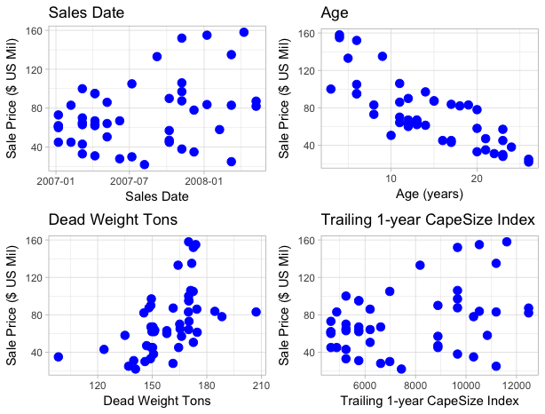
Market Landscape (current ship attributes)
Bet Performer
We can plot the relationship between sales price and other variables in our database. Then, we can draw a line representing the Bet Performer which might help identify similar ships and estimate price.

Slide 4
Market Approach/Nearest Neighbor estimate
A “market approach” estimates the value of a new ship by identifying a recently sold ship with comparable attributes. The assumption is that the most recent sale of a new ship is the best predictor of the next sale price, since,
Our database has two variables that deal with ship attributes: Deadweight Tonnage and Age-at-sale. We can use these to identify the most recent ship within +/- 2,000 Deadweight Tons, and within +/- 3 years of the Bet Performer – the Cape Sun, which sold for $135 million.
We could also expand this and identify all ships that sold within the past 17 months, and look at the range and average of their selling prices:
“In normalized and efficient markets, the price of a vessel is simply what a buyer, cognizant of the relevant facts and under no compulsion to act, would pay to acquire the asset from a knowledgeable seller equally under no compulsion to act. . . . [Both] the commercial and the academic values usually converge to the purchase price that a rational, well-informed investor (buyer) would pay for the acquisition of the vessel.”
Ship Name | Selling Price
TMT TBN | $61.30
Zorbas II | $86.00
Fertilia | $50.50
Ingenious | $64.20
Sumihou | $106.00
Cape Sun | $135.00
Average | $83.83
Range | $61.30 - $135.00

Slide 5
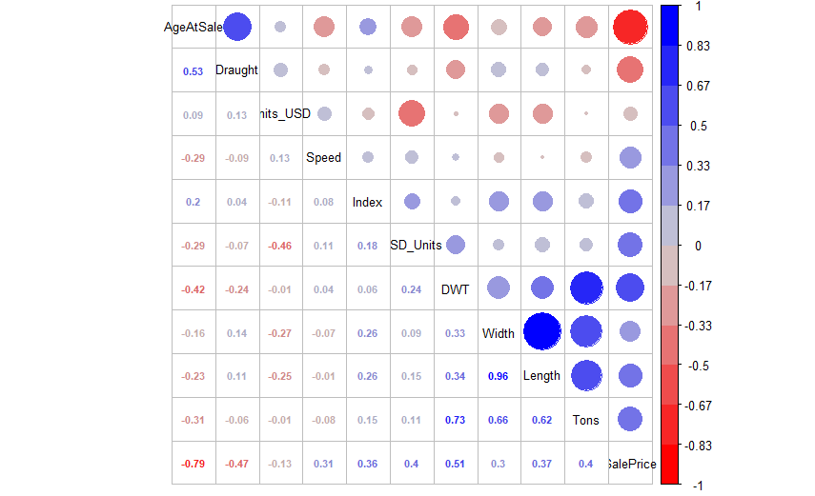
Variable Correlations
Before we build any models, we first want to understand relationships between variables in our data.
Strong correlations between Sale Price (the rightmost column) and other variables (represented by decimals approaching 1 or large circles) indicate ship attributes that will likely be predictive of price.
Strong correlations between ship attributes indicates that those attributes are highly connected, and that we should pick only one or the other when building our model.
Notes:
Correlation between variables causes collinearity. Consequently, regression coefficients biased by collinearity might cause variables that demonstrate no significant relationship with the outcome when considered in isolation to become highly significant in conjunction with collinear variables, yielding an elevated risk of false-positive results (Type I error). Alternatively, multiple regression coefficients might show no statistical significance due to incorrectly estimated wide confidence intervals, yielding an elevated risk of false-negative results (Type II error).

Slide 6
Market Approach Model
The problem with the “nearest neighbor” estimate is that it uses a single data point. What if we could use all of the data in our database? Surely that would give us a better estimate of the ship price!
If we build a linear regression model that uses ship age and deadweight tonnage to estimate sales price, we identify an equation:
Using the Bet Performer’s attributes (11 years old, 172 DWT), we can estimate a sales price of $90.52 million, with a 95% confidence interval between $49.03 and $132.01 million.
This seems low compared to our rough estimate based on neighboring ships. Was the sale of the Cape Sun ($135 million) an outlier, or is our model a poor estimator?
Price = 60.3520568 – 3.7195541 *Age + 0.4132831 *DWT

Slide 7
Market Approach + Economic Index Model
If we look at the date of sale, we see that price seems to trend upward over time. Similarly, as the Capesize Index increases, sale price increases. Let’s also include Capesize index economic date in our model!
The new model gives us the equation
Using the Bet Performer’s attributes (11 years old, 172 DWT), with the current Capesize Index (12479), we estimate a sales price of $125.83 million with a 95% confidence interval between $104.74 and $146.92 million.
44.225549983 – 4.543803922 *Age +
0.242154623 *DWT + 0.007206924 *CapesizeIndex
Price =

Slide 8
Comparing between models
So we have several models, each which provides a different result. Which model do we choose? How do we feel confident that it is the correct model?
R² is a measure of how much variance is accounted for by the model. The more variance the model accomodates, the more predictive it is. Thus, a higher R² value is better. The Adjusted R² value is used to compare between models with different numbers of inputs.
Model | R² | Adjusted R²
Price ~ Age, DWT | 0.6578 | 0.6426
Price ~ Age, DWT, Index | 0.9204 | 0.9150
The model with Age, DWT and the Index accounts for 26.26% more variance than the model using only Age and DWT

Slide 9
Comparing between models (part 2)
So we have several models, each which provides a different result. Which model do we choose? How do we feel confident that it is the correct model?
Using an ANOVA test to compare models, we see that there is a significant difference between the model that uses all three variables (Age, DWT, and Index) and the model that uses only two (Age, DWT). Our p-value is extremely small, meaning that the chance that Index does NOT have an effect on the model is negligible.
We can visualize the proportion of variance that each attribute accounts for in our model. Age and Index together account for almost all of the variance, while DWT only adds a very little bit to the predictivity.

Slide 10
Caveat Emptor
Purchasing a ship is a high-risk proposition. What other things should we consider?
We focused on linear models, while our attributes may not have defined linear relationships with price. It is possible that a non-linear model could improve prediction accuracy.
Hypothetically, more data would improve prediction (either more variables, or data about more ships). However, when we looked at additional variables, these were less predictive than the current model.
There may be additional attributes about the Bet Performer which we have not modelled that could raise or lower the price: ship condition, personnel requirements, average time-to-un/load, country of manufacture…
Are we bidding too high, which may cause difficulty recouping the investment? Are we bidding too low and will be outbid?
There has been a rapid increase in the Capesize Index which could signal a market bubble. The rule “buy low, sell high” comes to mind, and by purchasing now, it is likely that the client would be purchasing high, making recouping the investment a challenge. Unless there is a specific need right now, we might advise waiting to see if the market falls in order to get a better price.

